Slide 1
May 18, 2026
Ojai Valley Municipal Advisory Council Meeting
Camp Gilga Conditional Use Permit
Case No. PL25-0039
Resource Management Agency, Planning Division
Noe Torres, Senior Planner

Slide 2
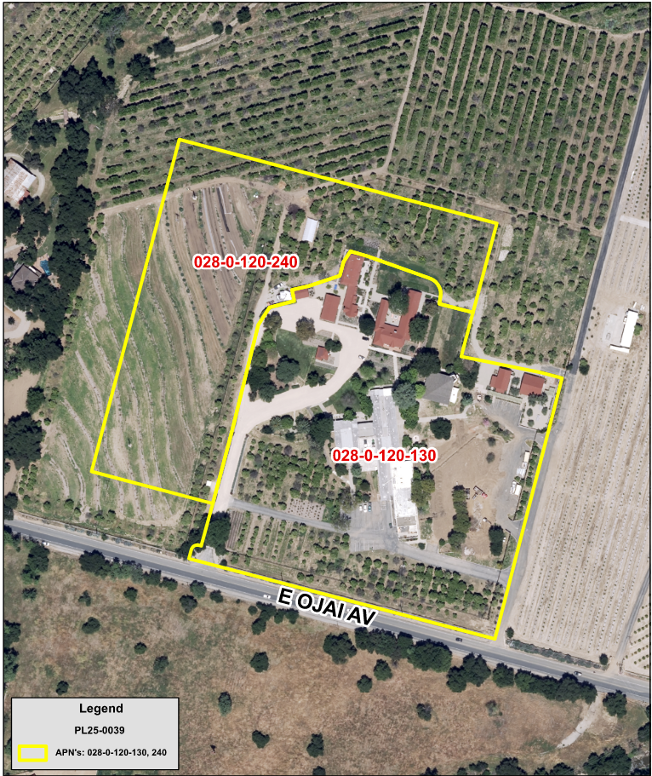
Site Location
2464 East Ojai Ave, Ojai, CA 93023
Project Site: 14.57 acres
CUP Boundary: 12.78 acres

Slide 3
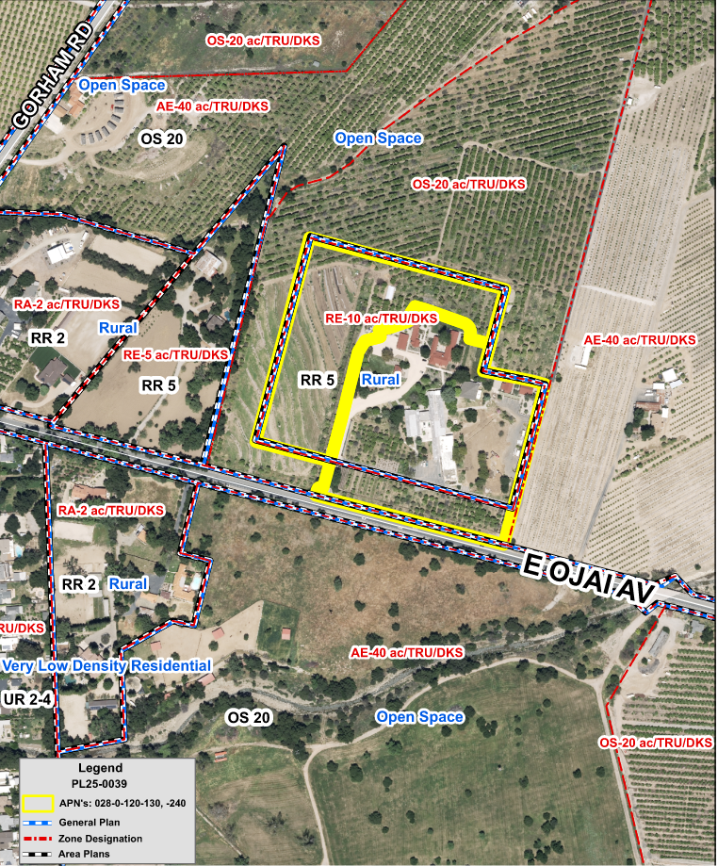
Zoning and Land Use Designations
General Plan: Rural
Area Plan: Rural Residential 5-10 AC Min
Zoning: RE-10 ac/TRU/DKS

Slide 4
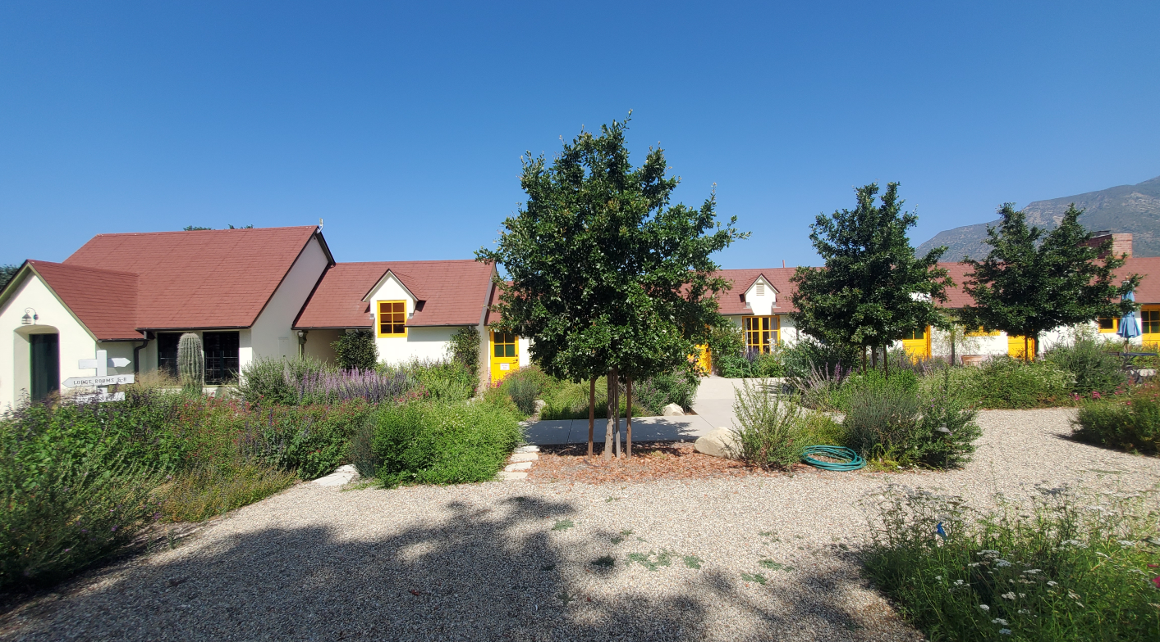
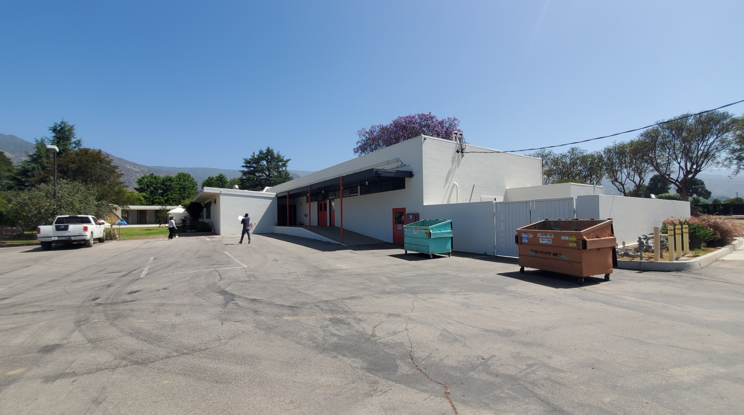
Site Photos

Slide 5
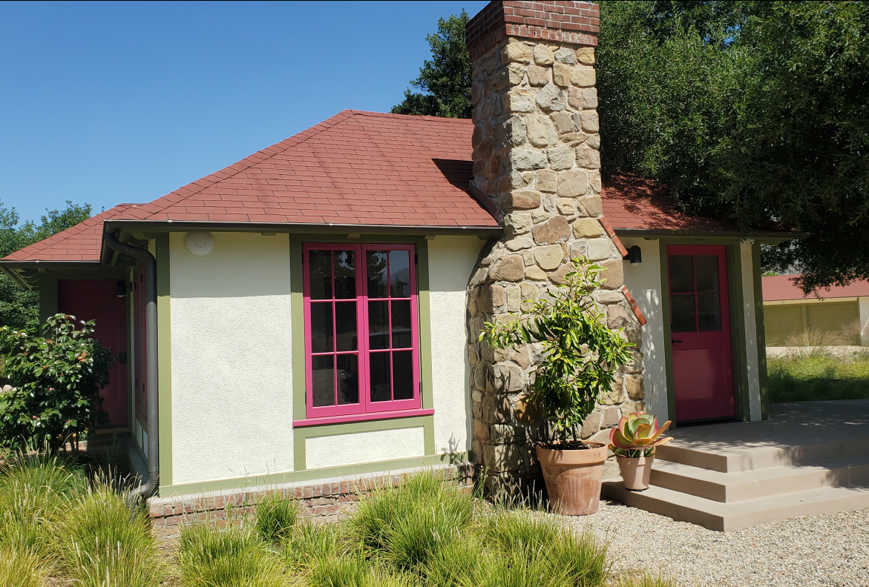
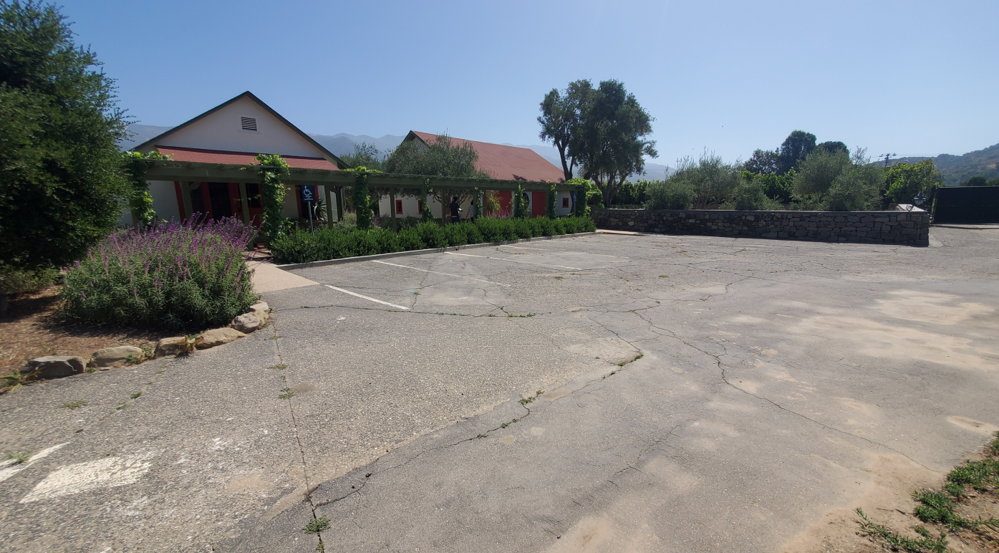
Site Photos

Slide 6
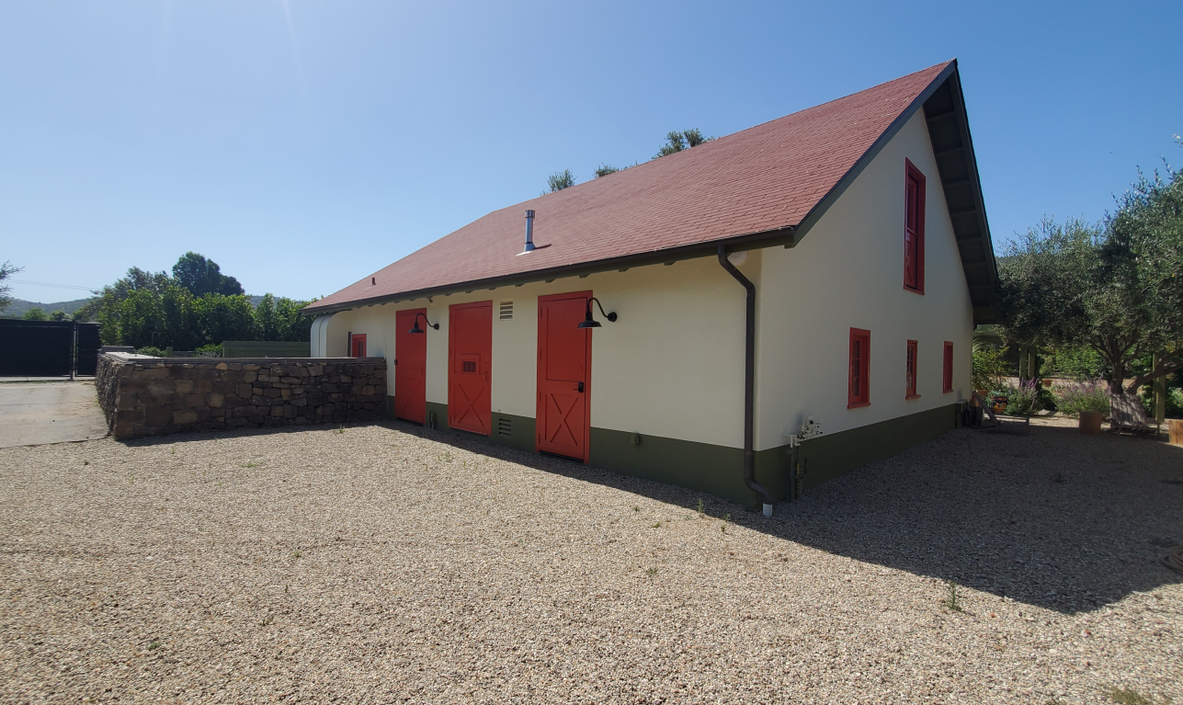
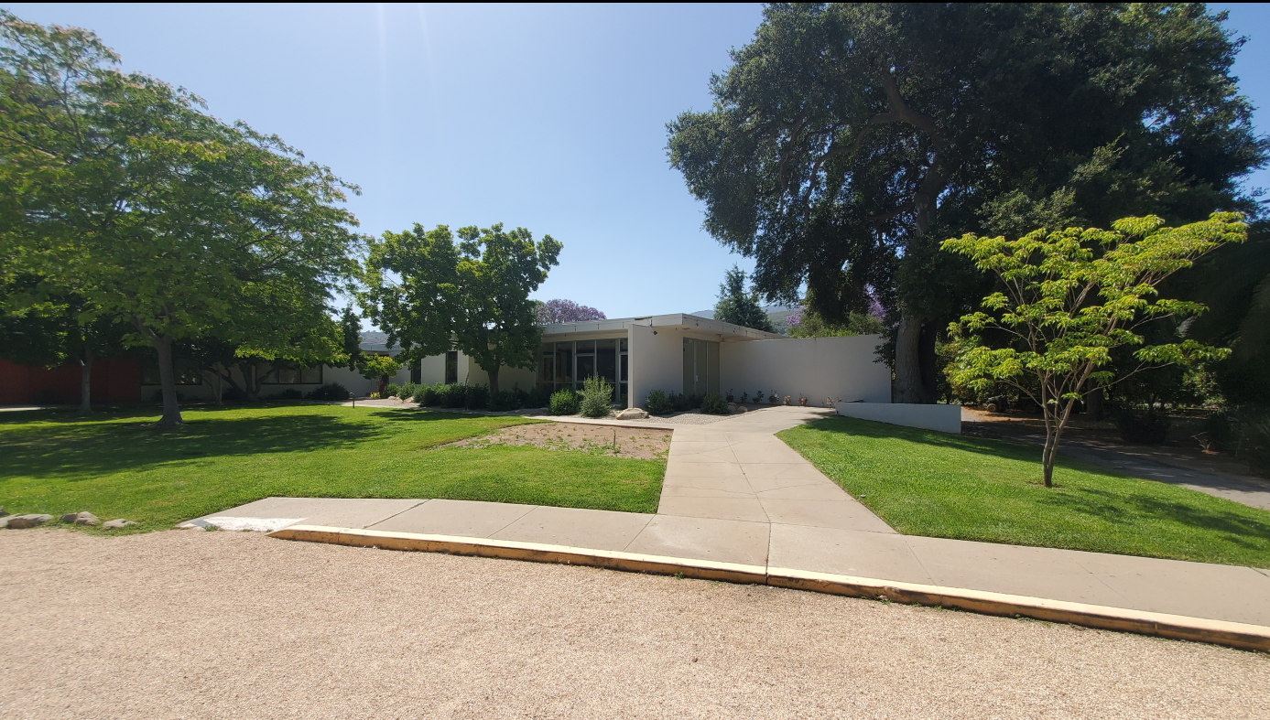
Site Photos

Slide 7
Project Description
Camp activities will combine working farm and arts
Use of existing historic structures
Phased Development to full build out
  261 Daytime Guests and staff
  130 Overnight Guests and staff
  25,502 SF of Camp Activity Structures
  25,515 SF of Overnight Accommodations Structures
  Encroachment onto TPZ of 49 protected trees and removal of 3 protected trees
  85 parking spaces

Slide 8
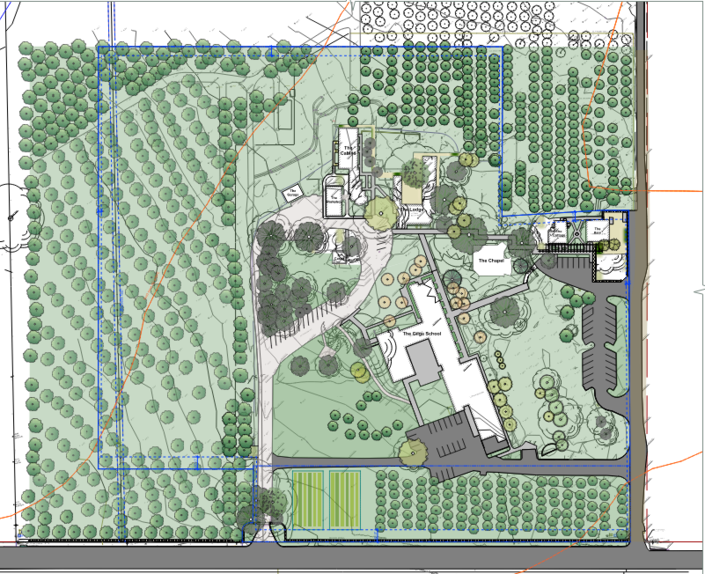
Existing Site Plan
Existing Structures
GFA: 26, 288 SF
Camp Activity Area: 17,084 SF
Overnight Accommodation: 4,186 SF

Slide 9
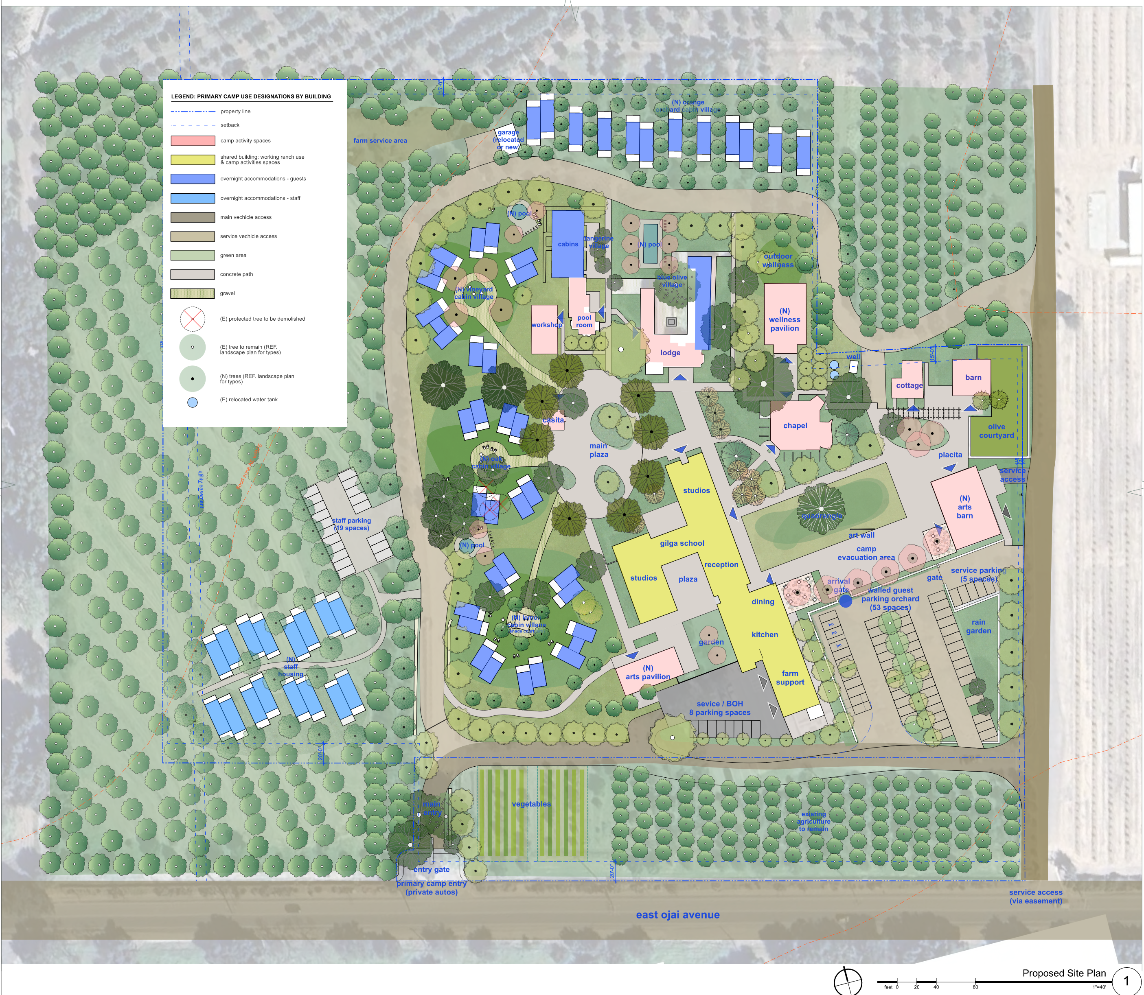
Proposed Site Plan
New Structures:
New GFA: 31,707 SF
New Camp Activity Area: 8,418 SF
New Overnight Accommodation: 21,329 SF

Slide 10
Non-Coastal Zoning Ordinance
NCZO Allowed Population
Daily Population (RE Zone) Daily Population (NCZO Section 8107-17(c)(1) and 8107-17(c)(3) | 12.78 ac X 20.48 = 261.73
Overnight Population (RE Zone) NCZO Sections 8107-17()(1) and 8107-17(b)(3)) | 12.78 ac x 10.24= 130.56

